Slide 1



Analyzing Equity and Political Bias in IIJA Funding Allocation
This study examines the Infrastructure Investment and Jobs Act (IIJA) allocations by state. We investigate funding equity based on population and potential political bias favoring Biden-supporting states.
by Waheeb Algabri

Slide 2


Study Objectives
1
Equity Analysis
Investigate IIJA funding allocation equity based on state population demographics.
2
Political Bias Exploration
Examine potential bias favoring states that supported President Biden in 2020.
3
Contextual Factors
Consider additional factors like state GDP, infrastructure spending, and debt levels.

Slide 3






Data Sources
IIJA Funding Data
Provided by Prof. Fulton, covering allocations up to March 2023.
Population Data
U.S. Census 2020-2023 estimates for accurate per capita calculations.
Election Results
State-level data on Biden vs Trump support in 2020 election.
Economic Indicators
State GDP, infrastructure spending, and debt data for context.

Slide 4


Methodology
1
Data Cleaning
Standardized and merged datasets from multiple sources for consistent analysis.
2
Metric Calculation
Computed spending per capita and classified states by 2020 election results.
3
Contextual Analysis
Incorporated debt per capita, GDP, and infrastructure metrics for comprehensive view.

Slide 5
Equity Analysis Findings
Large States
Small States
Implications
California and other populous states received significant total funding. Per capita allocation varied widely among these states.
Some smaller states received disproportionately higher funding per capita. This raises questions about allocation equity.
The disparity in per capita funding suggests potential issues in the equitable distribution of IIJA resources.

Slide 6

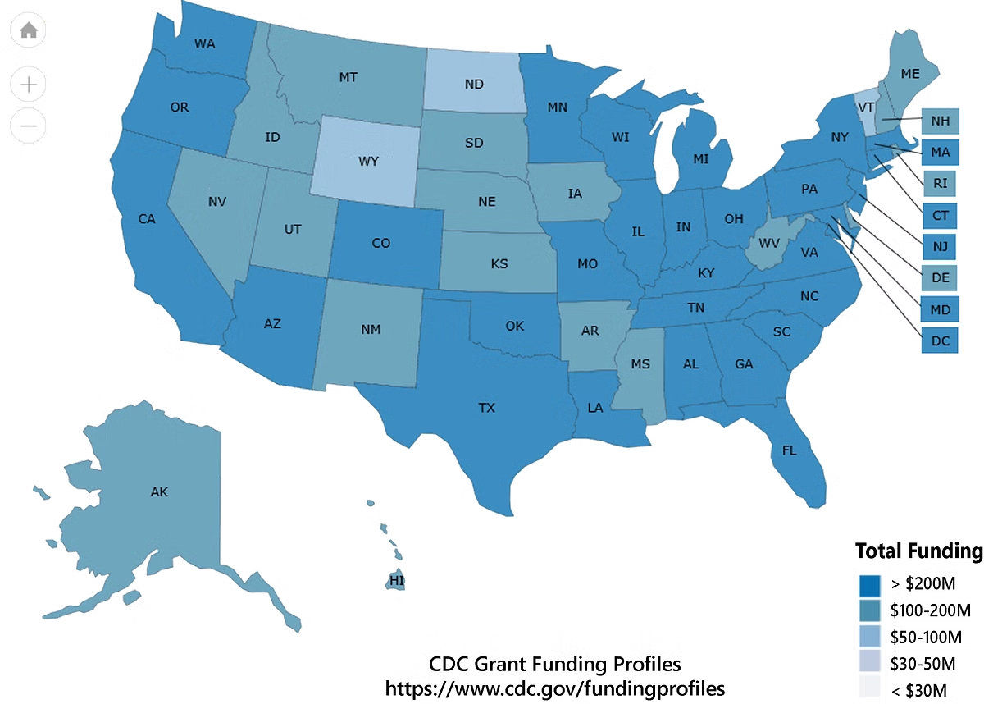
Political Bias Analysis Findings
Category
Average Funding Per Capita
Correlation with Swing State Status
Biden-supporting States
Slightly Higher
No Strong Correlation
Trump-supporting States
Slightly Lower
No Strong Correlation

Slide 7


Conclusion
Equity Concerns
IIJA funding shows variations in per capita spending. Smaller states often received disproportionate amounts.
Political Bias
No strong evidence of bias favoring Biden-leaning states. Slight funding edge may reflect other factors.
Complex Factors
Variations may be due to infrastructure needs, state proposals, or other underlying factors.

Slide 8





Future Research Directions
Project Types
Analyze specific infrastructure projects funded to understand allocation patterns.
Geographic Needs
Investigate how regional infrastructure requirements influence funding distribution.
Equity Dimensions
Explore additional equity factors such as income levels and existing infrastructure conditions.

Slide 9


Q&A Session
Thank you for your attention. We will now open the floor for questions and discussion about the IIJA funding allocation analysis.

